Slide 1
Computer Graphics Rendering
Lectures 13 ,14: Path tracing
Kartic Subr

Slide 2


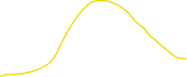
Recap: MC integration estimator
Sampler
function
pdf

Slide 3

Recap: MC integration estimator
Sampler

Slide 4

MC integration errors

Slide 5


Recap: impact of sampling pdf
Sampler
Sampler
Sampler

Slide 6




Dividing by the sampling pdf
Sampler
Sampler
Sampler

Slide 7

MC integration errors

Slide 8

MC integration errors

Slide 9

MC integration: importance sampling

Slide 10

Light transport

Slide 11


Incident or incoming radiance at x
$$n$$
$$x$$

Slide 12





Differential irradiance at infinitesimal patch
$\text{d}E_{i}$ = $L(x, ω_{i})\text{ (}ω_{i}\text{.}\text{n}\text{) }\text{d}ω_{i}$
$$n$$
radiance
$$L(x, ω_{i})$$
W m⁻²
differential irradiance at x,
due to one incident ray
W m⁻² Sr⁻¹
$$\text{d}ω_{i}$$
$$\text{dA}$$
$$x$$

Slide 13


Outgoing radiance along a direction
radiance
$$L(x, ω_{i})$$
$$L(x, ω_{o})$$
$$\text{d}ω_{i}$$
$$\text{dA}$$
$$x$$

Slide 14

Linear optics: reflected radiance ∝ irradiance
d$L\left(x, ω_{o}\right)$ p$roportional to \text{d}E_{i}$

Slide 15


Linear optics: reflected radiance ∝ irradiance
d$L\left(x, ω_{o}\right)$ = $ρ(ω_{i},ω_{o})$ $\text{d}E_{i}$

Slide 16

Constant of proportionality is a function!
d$L\left(x, ω_{o}\right)$ = $ρ(ω_{i},ω_{o})$ $\text{d}E_{i}$
Constant for a given pair of incident-outgoing directions
Determines appearance of opaque materials
Bidirectional Reflectance Distribution Function (BRDF)-

Slide 17



BRDF slice per incident direction
$$ω_{i}$$
$ρ(ω_{i},:)$
more light along
direction of specular reflection

Slide 18
BRDF slice per incident direction
$$ω_{i}$$
$ρ(ω_{i},:)$
more light along
direction of specular reflection

Slide 19
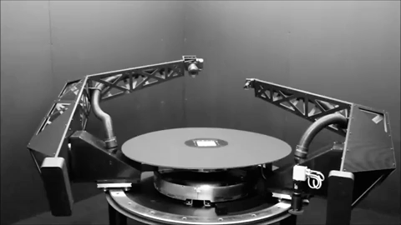
BRDF measurement - gonioreflectometer
tabulate 4D measured values?
[robotae]
http://www.cs.cmu.edu/afs/cs/academic/class/15462-f09/www/lec/lec9.pdf

Slide 20

phase functions
commonly used material models
BSDF
BSSRDF
SvBRDF

Slide 21


Reflection: multiple incident rays
$L\left(x, ω_{o}\right)$ = $\sum_{i}{ ρ(ω_{i},ω_{o}) \text{d}E_{i}}$
contributions for different directions weighted by BRDF

Slide 22


Add emission from surface at x
$L\left(x, ω_{o}\right)$ =$L_{e}\left(x, ω_{o}\right)$ + $\sum_{i}{ ρ(ω_{i},ω_{o}) \text{d}E_{i}}$
contributions for different directions weighted by BRDF

Slide 23


In the limit …
$L(x, ω_{o})$ = $L_{e}\left(x, ω_{o}\right)$. + $\int_{H^{2}}^{ }{ ρ\left(ω_{i},ω_{o}\right) L(x, ω_{i}) \text{(}ω_{i}\text{.}\text{n}\text{) }\text{d}ω_{i}}$
surface emission
hemisphere
BRDF
incident radiance
cosine dependence
… the rendering equation
[Kajiya 86]

Slide 24

In the limit …
$L(x, ω_{o})$ = $L_{e}\left(x, ω_{o}\right)$. + $\int_{H^{2}}^{ }{ ρ\left(ω_{i},ω_{o}\right) L(x, ω_{i}) \text{(}ω_{i}\text{.}\text{n}\text{) }\text{d}ω_{i}}$
surface emission
hemisphere
BRDF
incident radiance
cosine dependence
… the rendering equation
[Kajiya 86]

Slide 25
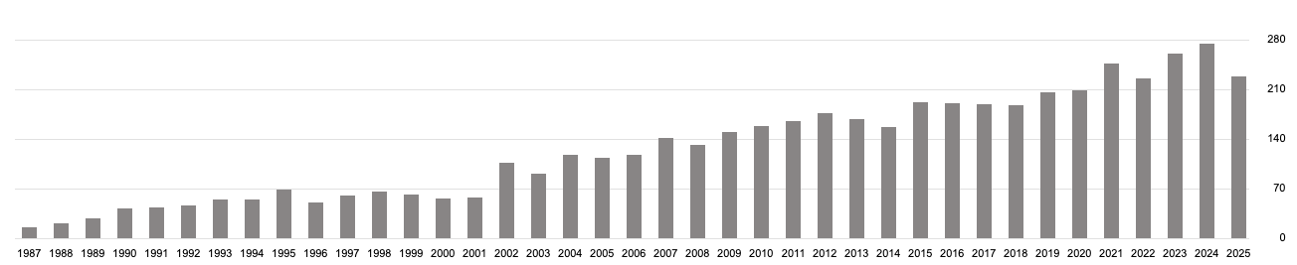
The rendering equation
Citations per year
(Google scholar)
[Kajiya 86] https://dl.acm.org/citation.cfm?id=15902

Slide 26
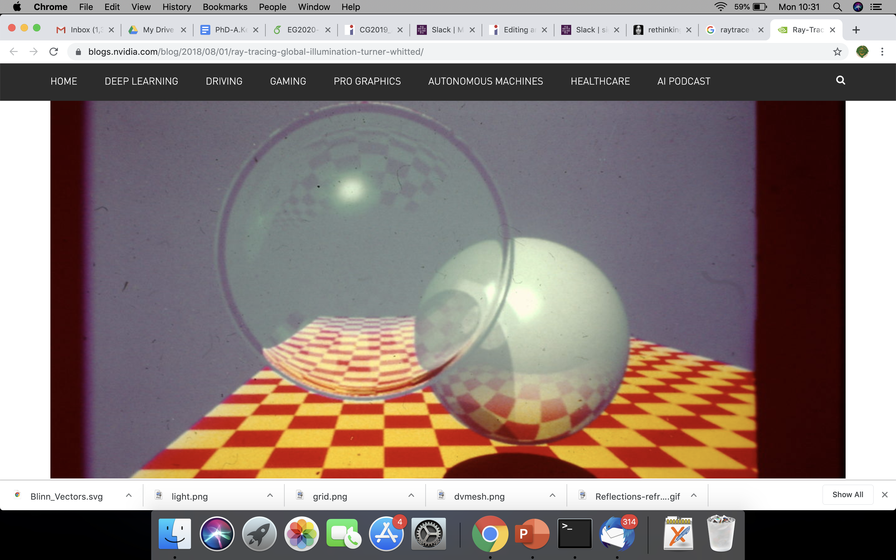
Contrast with Whitted raytracing
How to get ‘soft’ shading and lighting effects?

Slide 27
Solving the rendering equation

Slide 28


Estimate integrals recursively
1) Sample hemisphere at last bounce to camera

Slide 29
Estimate integrals recursively
1) Sample hemisphere at last bounce to camera
2) Trace each sample ray back to intersection

Slide 30
Estimate integrals recursively
1) Sample hemisphere at last bounce to camera
2) Trace each sample ray back to intersection
3) Sample those hemispheres
4) Recurse until k bounces
5) Use recursion results to estimate radiance

Slide 31
Estimate integrals recursively
k bounces with n samples each
= n^k samples per pixel
e.g. 8000 spp if n = 20 and k = 3

Slide 32
Let there be blur!
Numerical integration
aperture
time
materials
penumbra
Distributed ray tracing [Cook et al 1984]

Slide 33
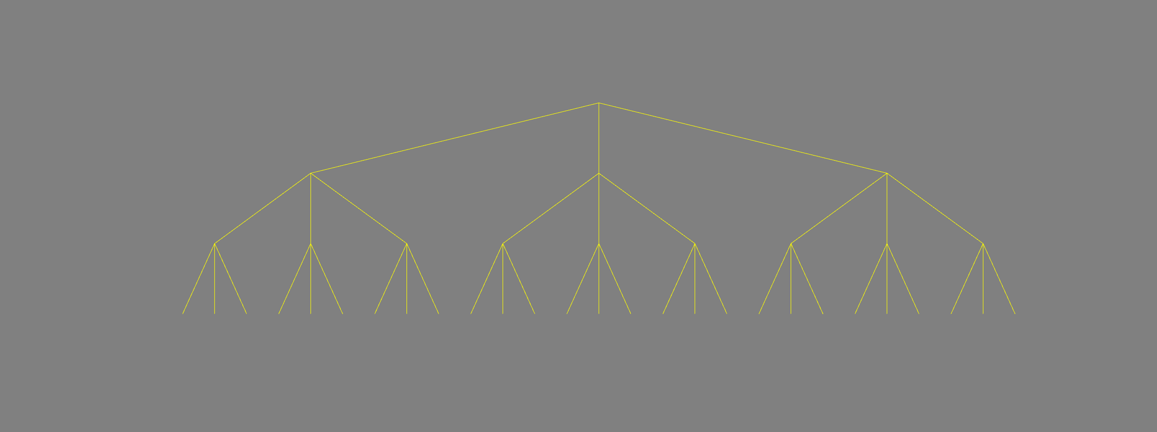
Whitted ray tracing – ray tree
primary ray
1 bounce
reflected ray
refracted ray
light ray
2 bounces
3 bounces : 3^3 = 27 rays

Slide 34
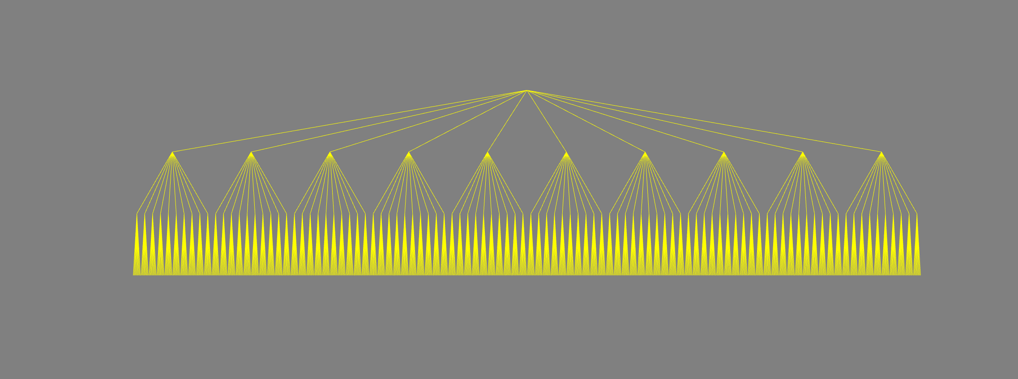
Distributed ray tracing – ray tree
primary ray
estimating integral by averaging
1 bounce
2 bounces
3 bounces : 10^3 = 1000 rays

Slide 35
Helps, but expensive!

Slide 36

Better way to solve the rendering equation?
estimating integral by averaging
path tracing [Veach98]

Slide 37
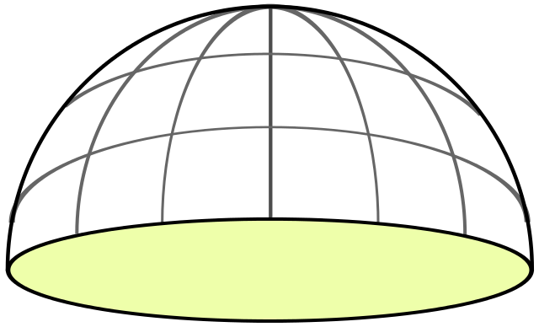
Random sampling at each level
x₁ drawn randomly in [0,1] x [0,1]

Slide 38
Random sampling at each level
x₂ drawn randomly in [0,1] x [0,1]

Slide 39
When to terminate?
x_{d} drawn randomly in [0,1] x [0,1]
?

Slide 40
When to terminate path?
Fixed depth d
When radiance is low
threshold
randomly
Russian roulette

Slide 41


More bounces? depends on scene
2 bounces
9 bounces
https://twitter.com/DisneyAnimation/status/1146085535057715200

Slide 42
Path tracing each pixel - overview
pixel area
2D
aperture
2D
2d+5 dimensions
exp. time
1D
bounces
d*2D
pixel value = average radiance
(over sampled paths)

Slide 43
Path tracing each pixel - overview
pixel area
2D
aperture
2D
2d+5 dimensions
N samples
per pixel
exp. time
1D
bounces
d*2D
pixel value = average radiance
(over sampled paths)

Slide 44
Path tracing: mapping samples to paths
pixel area
2D
aperture
2D
2d+5 dimensions
N samples
per pixel
exp. time
1D
map sample to path
& record radiance
randomly sample
the hypercube
bounces
d*2D
pixel value = average radiance
(over sampled paths)

Slide 45
Path tracing: mapping samples to paths
pixel area
2D
aperture
2D
2d+5 dimensions
N samples
per pixel
exp. time
1D
bounces
d*2D
randomly sample
the hypercube
map sample to path
& record radiance
pixel value = average radiance
(over sampled paths)

Slide 46
Path tracing - maths
pixel average radiance
pixel filter weighting
[https://jo.dreggn.org/path-tracing-in-production/2019/index.html

Slide 47
http://madebyevan.com/webgl-path-tracing/

Slide 48
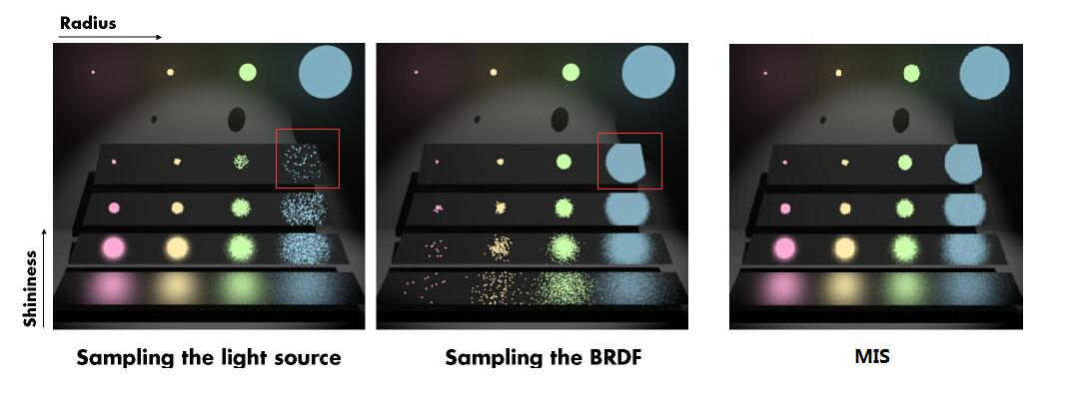
Importance sampling paths

Slide 49
Importance sampling paths

Slide 50
Importance sampling paths

Slide 51
This course so far …
maths
physics
self-learning
programming

Slide 52
This course so far …
self-learning
maths
physics
programming

Slide 53
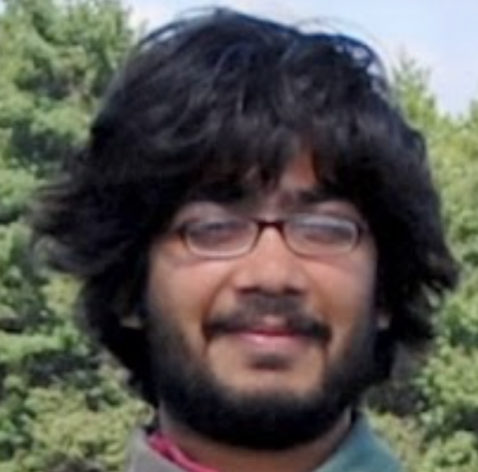
This course
v 1.0 (2007, Columbia University, NY)
Evolved
current trends/needs (e.g. online resources, LLMs)
mixture of fun + skills (awareness vs career in CG)

Slide 54
Feedback/appraisal
Piazza (anonymous)
email me (personal)
Love the course? Consider nominating me …
(will open later)
https://www.eusa.ed.ac.uk/whatson/awards/teachingawards

